Slide 1

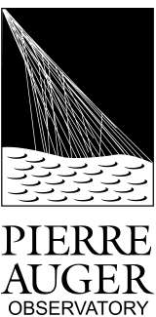
Mean and RMS of the Number of Muons
M. Oliveira, L. Cazon, R. Conceição, M. Pimenta
Analysis Meeting Malargue
12th November 2012
μ

Slide 2

Outline
Reconstruction Method
EM contamination
Calibration
Bias and Resolution
Application to Data
Understanding Fluctuations
Conclusions and Prospects

Slide 3
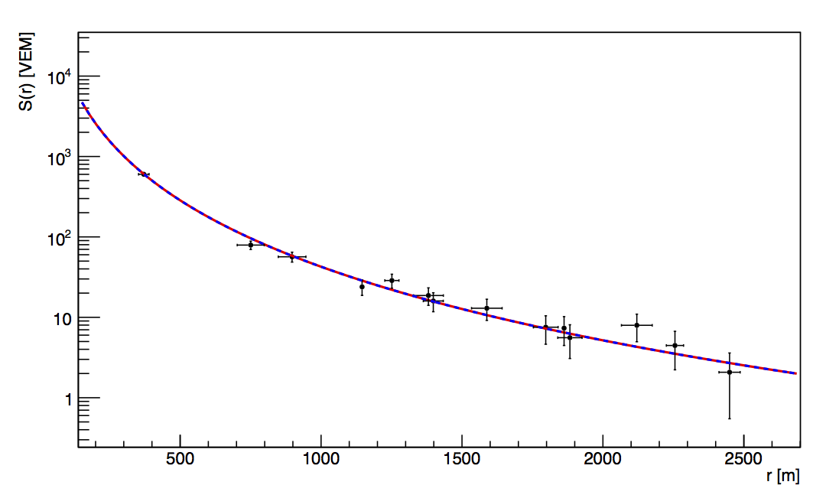
Reconstruction Method
Method to recover the number of muons on the ground from the LDF
Signal as a function of r the distance to the shower core in the perpendicular plane
Signal on the ground is due to various components:
At theta=60 the EM component is small, the signal in the tanks is dominated by muons
Muons give signals proportional to their tracks
The muonic signal in the tanks can be expressed as:
NKG:

Slide 4
Reconstruction Method
Averaging the Signal:
And from the projected area:
Finally we get the number of muons on the ground from the Signal:
Number of muons from the fit to the signal sampled by the SD

Slide 5
Simulations
The integral of the LDF will be evaluated for various r-cuts
Assess the best r-cuts for the resolution and bias
Good separation between the Proton and Iron muon distributions
50 Shower Simulations with CORSIKA for proton and iron Qgsjet-II.03
Energy = 10^{18.6} – 10^{19.5} eV
Theta = 60°
random Phi
5 different realizations for each CORSIKA simulation
Total of 250 Reconstructed events for Proton and Iron
N_{μ} TRUE: Number of Muons obtained from the CORSIKA simulated files
N_{μ} REC: Number of Muons obtained from our reconstruction using the LDF

Slide 6
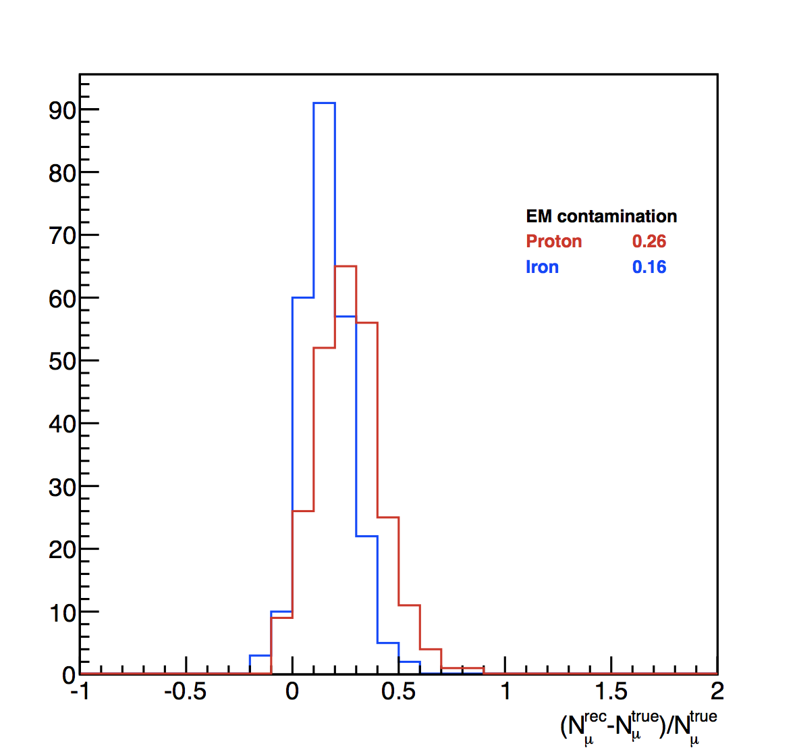
Signal Contamination
Electromagnetic halo decreases with the distance to the shower core
The method considers all the signal in the stations, EM halo included
Need for a Calibration in order to attenuate the electromagnetic halo
EM contamination: 15% - 30%
Depends on Primary Energy
Depends on zenith angle

Slide 7
Calibration
Fit to N_{μ}(Rec) vs N_{μ}(True) to get parameters in order to attenuate the EM component.
Calibration relative to the True number of muons
Number of muons without the EM component
alpha an beta are the calibration parameters
Fit to alpha an beta in order to recover values for all energies

Slide 8
Bias & Resolution
We apply the Proton primary calibration to Proton and Iron primaries
After the calibration:
Pull Distributions give the Bias and the Resolution of the Method
Fit in order to determine the distribution for any given energy

Slide 9
Application to Data
Application to SDHASRec Data (2004-2012 except 2009)
Cuts:
Energy Bins [E +/- 0.05]
Theta [58.5 – 61.5]
T5 Trigger
Energy | 18.6 |  | 18.8 |  | 19.0 |  | 19.2 |  | 19.4 |  | 19.5
Events | 600 |  | 261 |  | 113 |  | 47 |  | 15 |  | 5
 | Mean x10⁶ | RMS x10⁶
P | 4.96 | 1.08 | 6.72 | 1.54 | 10.2 | 1.94 | 15.6 | 2.33 | 25.0 | 4.11 | 30.9 | 5.02
Fe | 6.13 | 0.97 | 8.60 | 1.21 | 13.1 | 1.70 | 19.8 | 2.34 | 30.9 | 2.89 | 39.8 | 3.61
DATA | 9.85 | 1.17 | 15.2 | 1.56 | 23.5 | 2.23 | 37.3 | 3.35 | 56.3 | 4.20 | 69.7 | 4.78

Slide 10
Muonic Distributions
10^{18.6}
10^{18.8}
10^{19.0}
10^{19.2}
10^{19.4}
10^{19.5}

Slide 11
Elongation Rate
5
15
47
113
261
Resolution
600
β (proton) = 0.91
β (iron) = 0.91
β (data) = 0.95 +/- 0.05
Preliminary

Slide 12
Application to Data
Application to GoldenRec Data (2004-2012 except 2009)
Cuts:
Energy Bins [E +/- 0.05]
Theta [56. – 64.]
T5 Trigger
FD HasEnergy with Energy Resolution 20%
Energy | 18.6 |  | 18.8 |  | 19.0 |  | 19.2 |  | 19.4 |  | 19.5
Events | 192 |  | 97 |  | 49 |  | 28 |  | 16 |  | 12
 | Mean x10⁶ | RMS x10⁶
P | 4.96 | 1.08 | 6.72 | 1.54 | 10.2 | 1.94 | 15.6 | 2.33 | 25.0 | 4.11 | 30.9 | 5.02
Fe | 6.13 | 0.97 | 8.60 | 1.21 | 13.1 | 1.70 | 19.8 | 2.34 | 30.9 | 2.89 | 39.8 | 3.61
DATA | 9.07 | 2.94 | 13.6 | 4.34 | 23.2 | 6.03 | 33.2 | 8.9 | 48.1 | 7.03 | 60.0 | 14.4

Slide 13
Elongation Rate 20% E_{FD} Resolution
12
16
28
49
97
192
Resolution
β (proton) = 0.91
β (iron) = 0.91
β (data) = 0.93 +/- 0.018
Preliminary

Slide 14
Application to Data
Application to GoldenRec Data (2004-2012 except 2009)
Cuts:
Energy Bins [E +/- 0.05]
Theta [56. – 64.]
T5 Trigger
FD HasEnergy with Energy Resolution 5%
Energy | 18.6 |  | 18.8 |  | 19.0 |  | 19.2 |  | 19.4 |  | 19.5
Events | 54 |  | 22 |  | 25 |  | 13 |  | 5 |  | 7
 | Mean x10⁶ | RMS x10⁶
P | 4.96 | 1.08 | 6.72 | 1.54 | 10.2 | 1.94 | 15.6 | 2.33 | 25.0 | 4.11 | 30.9 | 5.02
Fe | 6.13 | 0.97 | 8.60 | 1.21 | 13.1 | 1.70 | 19.8 | 2.34 | 30.9 | 2.89 | 39.8 | 3.61
DATA | 9.50 | 2.45 | 14.5 | 3.41 | 24.0 | 5.8 | 31.9 | 8.1 | 48.4 | 8.46 | 62.8 | 14.3

Slide 15
Elongation Rate 5% E_{FD} Resolution
7
5
13
25
23
54
Resolution
β (proton) = 0.91
β (iron) = 0.91
β (data) = 0.92 +/- 0.03
Preliminary

Slide 16
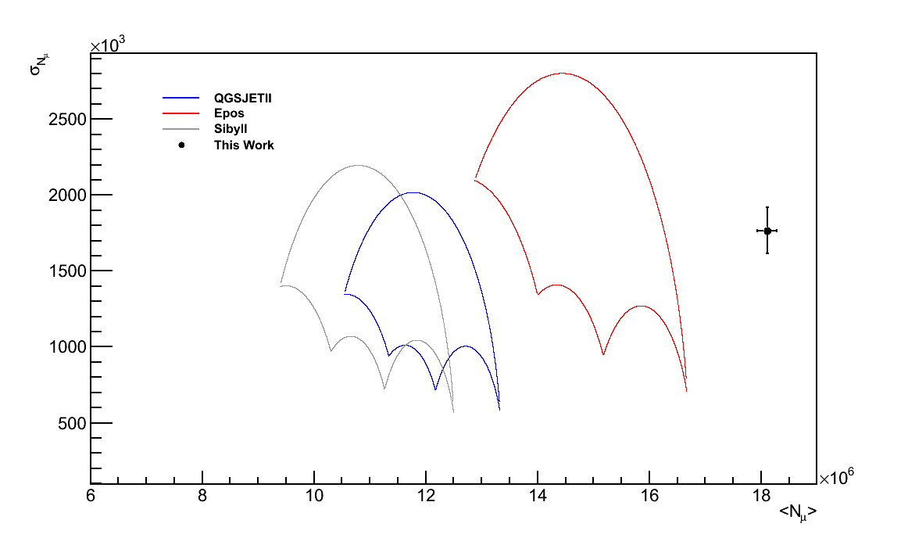
Umbrella
These parabolas define a closed contour that contain all possible combinations of mass mixtures for A[1-56]
E = 10¹⁹eV
Two first momenta of the distribution N_{μ} and RMS(N_{μ})
The result obtained is not compatible with any of the hadronic interaction models
Systematics to be included

Slide 17
Umbrella
10^{19.4}
10^{19.2}
10^{19.5}
10^{19.0}
10^{18.8}
QGSJET II
10¹⁹
10^{18.6}
Preliminary

Slide 18
Reconstruction Resolution
Understand the Reconstruction Resolution both on the Mean and the RMS of N_{μ}
Build a Monte Carlo Model:
Energy resolution of 20% (smearing)
Introduce Structure (kink) at give energies by changing β
Study possible structure on the Elongation rate
Fit with Simple and Broken Power Law
Chi/NDF in order to study the fit
Β evolves from 0.7 to 1.1
300 events for each beta
Total of 2000 Events with log(E)>18.4

Slide 19
Reconstruction Resolution
Power Law
Broken Power Law
Δβ = 0
CHI/NDF
1.1
CHI/NDF
0.9
Δβ = 0.2
CHI/NDF
1.4
CHI/NDF
1.0

Slide 20
Reconstruction Resolution
18.8
19.4
Evolution of Chi/NDF as a function of Δβ

Slide 21
Understanding Fluctuations
On the RMS(N_{μ)}: How does the Resolution of Energy impacts the RMS of the muonic distribuions
Due to the Spectrum
Resolution
We can evaluate the RMS(N_{μ}) using dN/dN_{μ}
Possible Corrections to the RMS might come from this study

Slide 22
Conclusions and Prospects
Encouraging preliminary results
Simple method that allows to obtain the distribution of the number of muons
Study of their shape, analysis of the momenta of the distribution
Measure more muons than the previsions of the models, in accordance with previous works
Second Momentum of distribution is RMS -> Important study to follow on the RMS of the number of muons
Gain a better understanding of the origin of the fluctuations
Work in Progress

Slide 23

Thank You!

